Slide 1

Technology Vision and Direction
Ken Cheng
CTO and VP, Corporate Development and Emerging Business
#BRCDTechDay
Notes:
We are in the dawn of an industry revolution… in the magnitude of the transition from Analog to Digital … Or similar to the emergence of the Internet.
Technology disruptions, combine with a remarkable market pull, is creating this revolution.
I want to start my presentation this morning with a quote from Steve Hilton who is the CIO of Credit Suisse. His quote is a perfect illustration of this market pull that we are seeing.
<click>

Slide 2
“Fundamentally we’ve had to redesign and challenge the way we’ve run distributed infrastructure for the past 15 years.
Not a single thing that we’ve done in the past is now acceptable for the future.”
Steve Hilton, Chief Information Officer, Credit Suisse Group
Notes:
…
<click>
“Not a single thing that we’ve done in the past is now acceptable for the future”.
The future, it turns out, will see networking turned on its head.

Slide 3

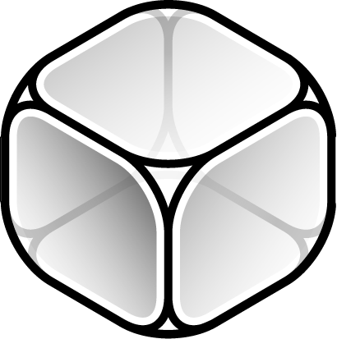
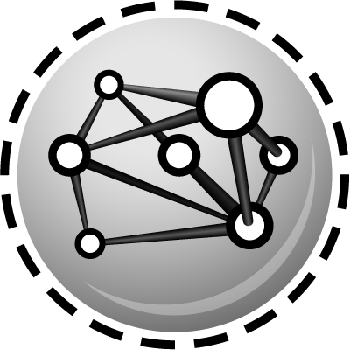

Capture Historic Industry Shifts
Closed to Open
Blurring of Hardware and Software
Software Defines Everything
Cloud Evolution
Flexible, Efficient, Programmatic, Elastic
Notes:
Technology disruptions are driving industry shifts, forcing us to fundamentally rethink how networks should be architected, designed, deployed and operated. Here is our vision of the future:
We see a clear shift from closed to open systems,
We see the changing roles of hardware and software
We see the world is becoming software centric
And we are seeing an evolution of cloud.
As a whole, we are seeing a shift toward an OPEN, more flexible, efficient, highly programmable and elastic network infrastructure

Slide 4
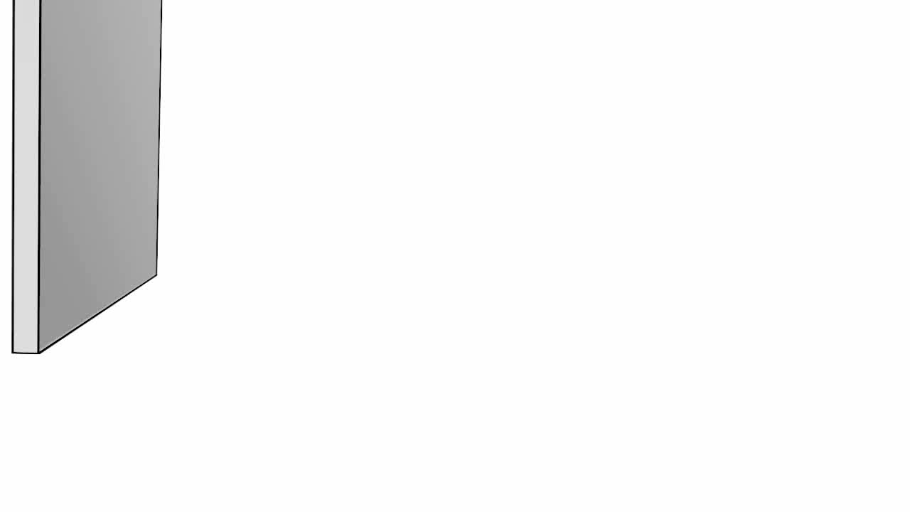
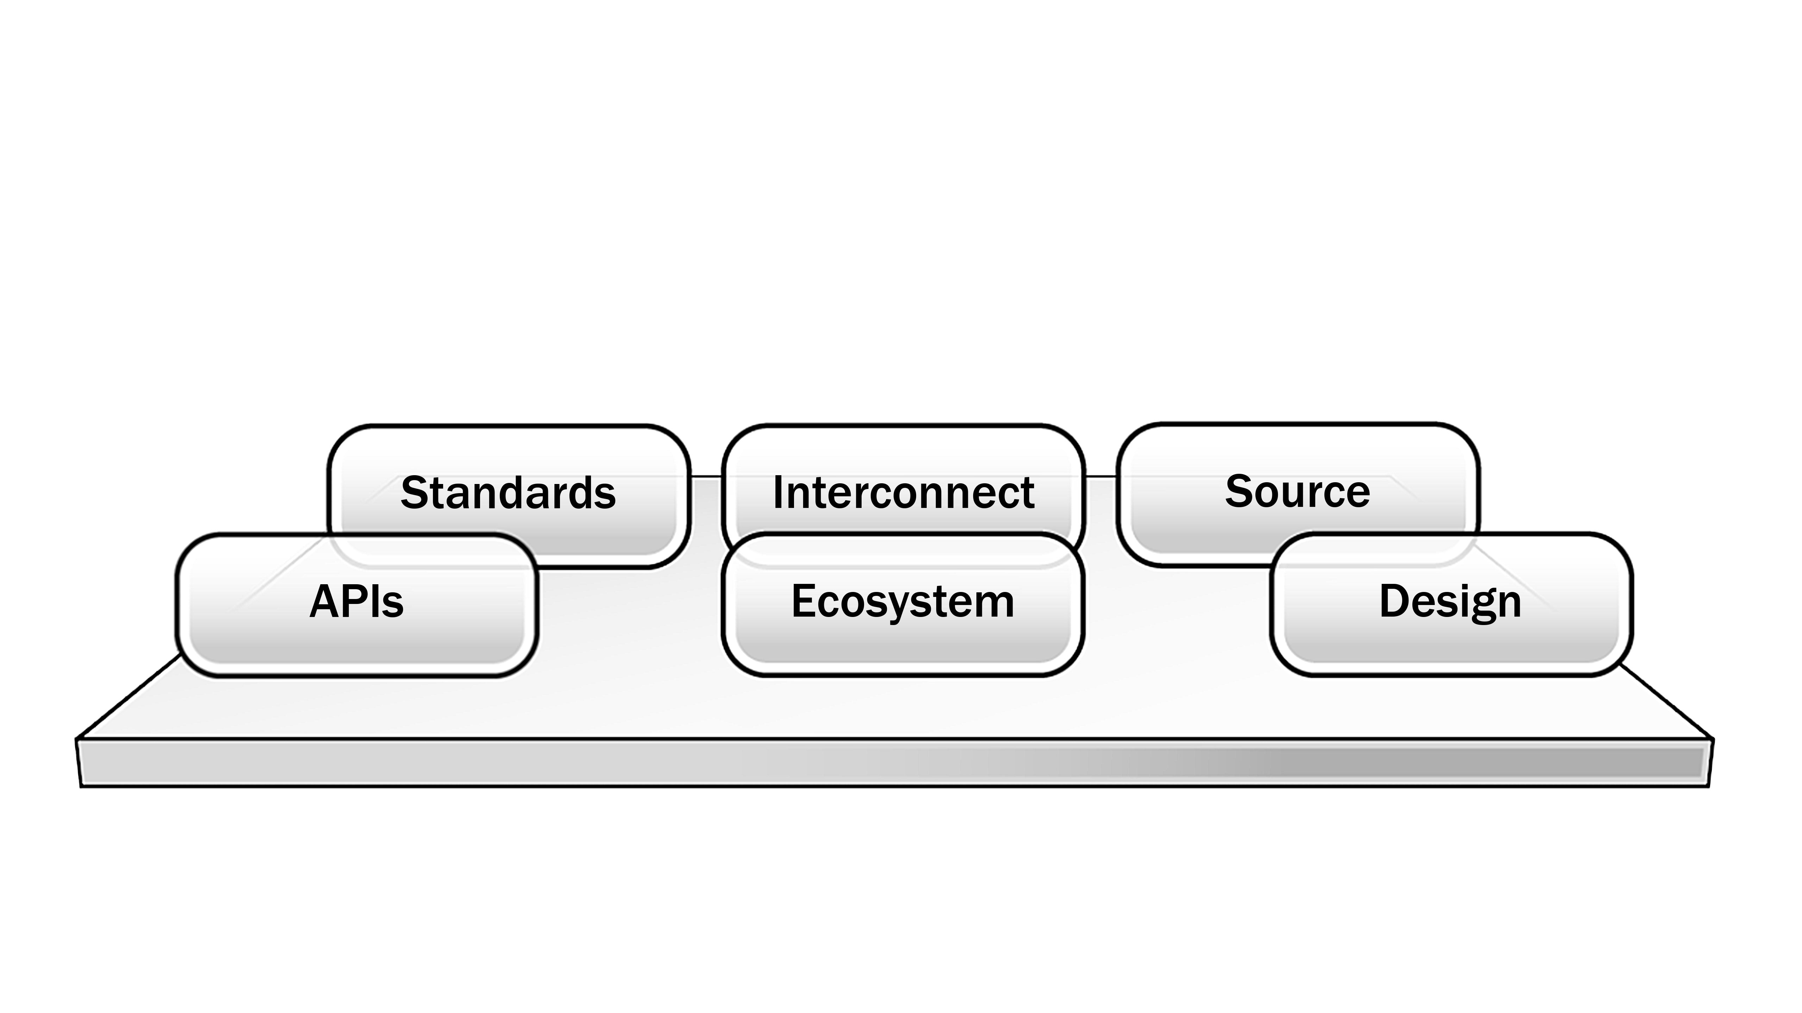
OPEN
PROPRIETARY PLATFORMS
Notes:
The era of proprietary systems is coming to an end.
<click>
We are in an Open era. Traditional systems are horizontalized, modularized, disaggregated, componentized and everything is pluggable.
Open will spark more collaboration around the development of technologies and stimulate a vibrant ecosystem for the next-gen data center.
Open will enable a faster pace of innovation in networking;
Open will transform every aspect of the data center, from software, hardware systems, mechanical design, power and cooling.

Slide 5

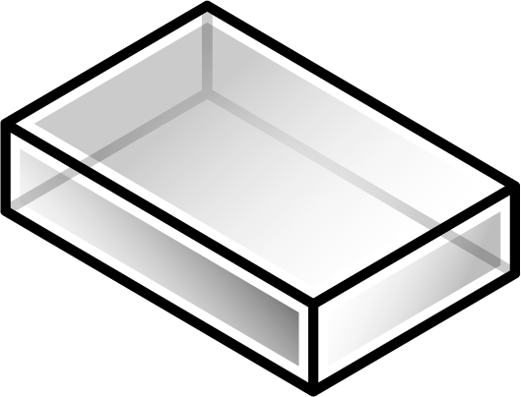
Blurring Hardware and Software Boundary
Exponential Growth of x86 Performance
Virtual Router
Virtual Route Reflector
Virtual Middleboxes
Virtual CPE
Virtual EPC
2008
2009
2010
2011
2012
2013
Platform Harpertown Nehalem Westmere Sandy Bridge Ivytown
Total Cores 8 8 12 8 16 20
Notes:
Technology advances are changing the roles of networking hardware and software.
The performance of Intel compute platforms continue to demonstrate exponential gain, enabling software to perform tasks that were once only possible with specialized hardware. As a result, the line between hardware and software continue to blur. Today, using the new 20 core Intel Ivytown platform, you can achieve almost 200G wire-speed performance with software.
This disruption is behind a sweeping industry movement called Network Function Virtualization (NFV) which is seeking to move proprietary appliances to software. With NFV, you will see a new generation of virtualized products.
In case you are wondering, networking hardware is not going away. You will always need a hardware substrate for your data center. But the role of hardware will be changing. This shift between networking hardware and software will afford tremendous growth opportunities to Brocade; We intent to lead the emerging market of software networking, while delivering a highly differentiated fabric infrastructure.

Slide 6
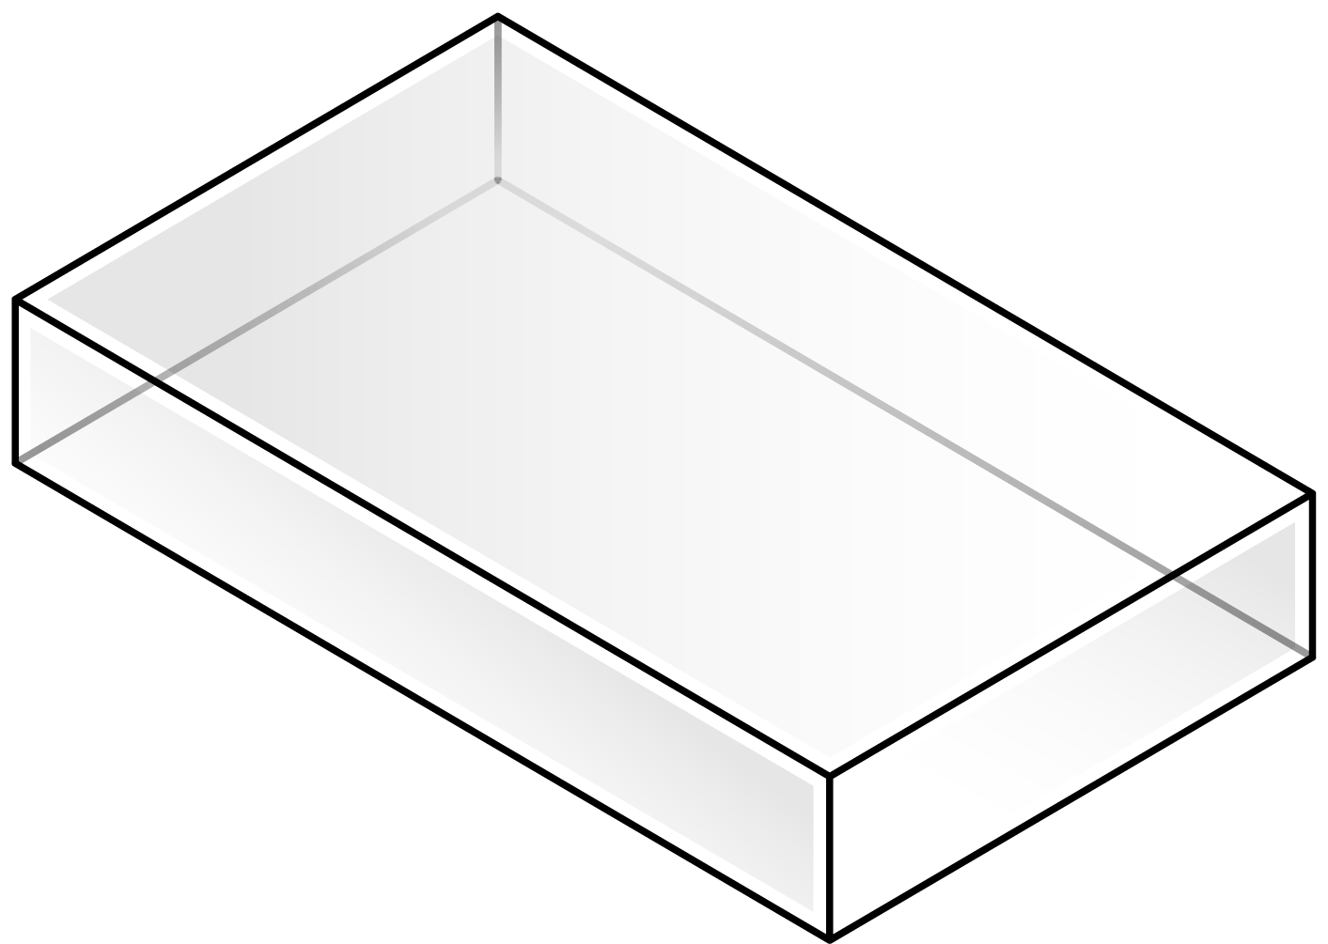

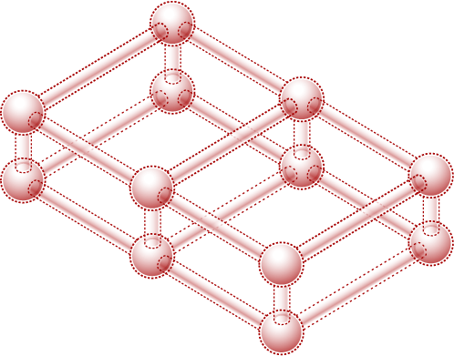
Connecting IT and Networks
IT
SDN
NETWORK
Notes:
Software defined networking will take center stage in networking.
Traditionally, IT is about deploying compute workloads with storage. With virtualization, IT workloads can be deployed in minutes. The next-generation of IT is cloud centric and IT will be delivered as service. While IT does not really care about network plumbing, networking has always been on its way. Network changes typically takes days if not weeks, while IT wants to provision infrastructure within minutes.
So there is a fundamental disconnect, until now.
[click]
I have a simple definition of SDN - SDN is a set of technologies which enables cloud-centric IT to join with networking, finally, for the first time.
SDN gives IT the tools to define exactly what it wants the network to do, and to execute the changes on demand, when the applications need it.

Slide 7



Evolving Cloud Services
PUBLIC CLOUD
SERVICES CLOUD
Basic
Uniform
Low Cost
Rich Services
Application Optimized
Public cloud architecture
Enterprise Policies
Increased Security
Notes:
Cloud is evolving.
The first generation of cloud is revolutionary but basic. Customers get basic IT services at lower cost. Services are uniform for all customers. Customers must make tradeoffs between cost and capability.
[click]
The next generation of cloud, we call it Services Cloud, will be much more capable; It will offer rich private cloud like services. It will reflect public cloud architectural principles but with enterprise constraints and policies. A good example for the Next-Gen Cloud is the Amazon GovCloud for US government agencies. GovCloud conforms to the US ITAR regulation and the FedRAMP requirements.
These clouds will CO-EXIST, serving a diverse set of customers and requirements.

Slide 8

Brocade Technology Direction
Notes:
Let me move on to talk about Brocade technology direction.

Slide 9
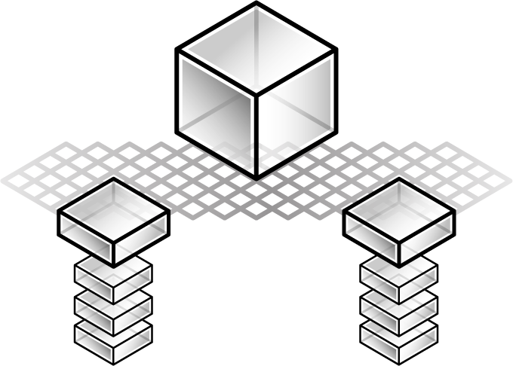
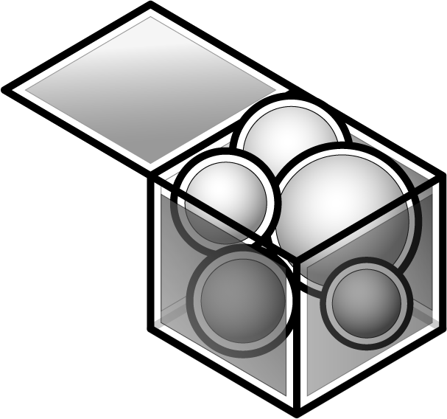
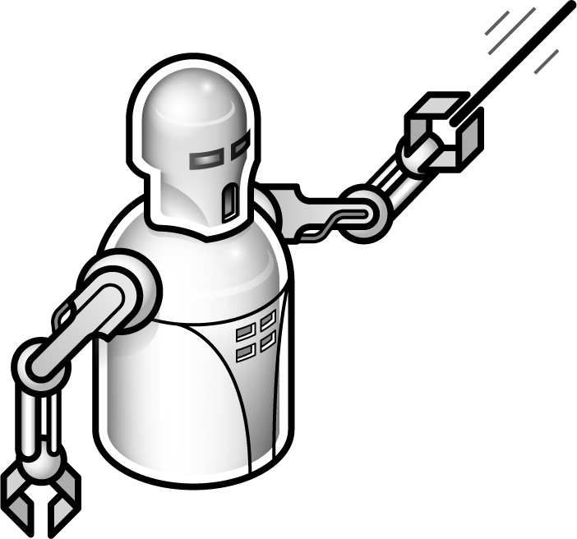
Brocade Technology Focus Areas
Data Center Networking
Ethernet Fabric
Software Networking
SDN, NFV
Orchestration
OpenStack, OpenDaylight
Notes:
Our first core technology focus is Data Center Networking around Ethernet Fabric.
In a software-defined data center, fabric is essential and fundamental.
But what is it really about fabric that is so critical for the modern data center? Why is it the necessary foundation for cloud infrastructure?
The answer is actually surprisingly simple.
In modern data center, compute, storage and network will be available as generic pools of resources. The fundamental idea is that in this environment workload can run anywhere with UNIFORM access to bandwidth with consistently low latency. This basic requirement is not achievable with the classic 3-tier networks. The 3-tier network is built to support north-south traffic profile, and assumes reduced bandwidth as traffic moves northbound. As a result, workload must be manually placed with specific knowledge of the physical topology. In this legacy environment, workload placement matters a great deal. Otherwise, you will have suboptimal network and compute utilization in your data center.
This is simply unacceptable for the next generation data center.
This is why we invented Ethernet Fabric as one of our core differentiations.
Ethernet Fabric is designed to optimize east-west traffic. It does not constraint workload placement. It assures bandwidth and latency requirements of any workload. It operates as a virtual high-speed interconnect which optimize all data center workloads. Without a fabric infrastructure, one would have to work around the workload placement problem manually or through complex software workarounds.
<click>
Our second core technology focus is Software Networking around SDN and NFV.
The future of the networking will be software centric. We envision routing in highly virtualized data center with multitenant workloads to be pervasive, as customers replicate their physical network in the virtual environment. Our software networking innovation will focus on virtual routing with integrated services to enable efficient service chains.
Leveraging the performance of the Intel platforms, with our open control plane and data plane accelerations, we have the technology underpinnings to power the Network Function Virtualization movement. We will deliver some of the key NFV use cases such as NFV Infrastructure as a service, Virtual Network Function as a service and Virtual Network Platform as a service. Today we are virtualizing an increasing number of network functions including tenant routing, branch routing, firewalls, load balancing and NAT. Moving forward we will help operators to virtualize networks of appliances, such as the mobile Evolved Packet Core.
<click, show the orchestration>
In order to fulfill the promise of SDN, our products, hardware and software, will operate seamlessly in an open ecosystem under SDN orchestration. All of our products will be programmable in the management, control and data planes. We will play an active role in the Openstack and OpenDaylight projects and make contributions to help evolving them into the orchestration frameworks of the future.
Our commitment to innovation goes beyond products. We are embracing the DevOps product delivery model to effectively integrate planning, development, QA testing and deployment processes to enhance quality, time-to-customer feedback, and time-to-market.

Slide 10

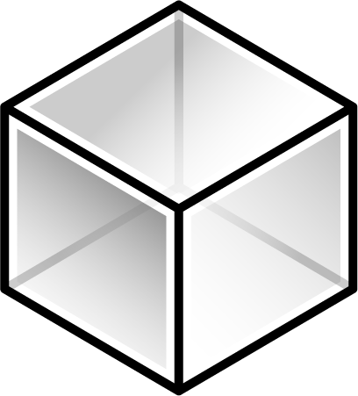
Competitively Positioned
Proprietary software
Proprietary hardware
Open, Virtual, Simple
Notes:
The future of networking is about openness. Customers want choices. Customers want everything componentized, pluggable and best-of-breed. We will be our industry’s leading champion of OPEN networking.
Customers also want an efficient and seamlessly collaborative virtual and physical infrastructure.
Closed and vertically integrated architectures, whether hardware or software, will not deliver the best-of-breed and investment protection customers are looking for.
Moving forward, for everything we build, both hardware and software, will conform to the architecture principles of open, virtual and simple.

Slide 11


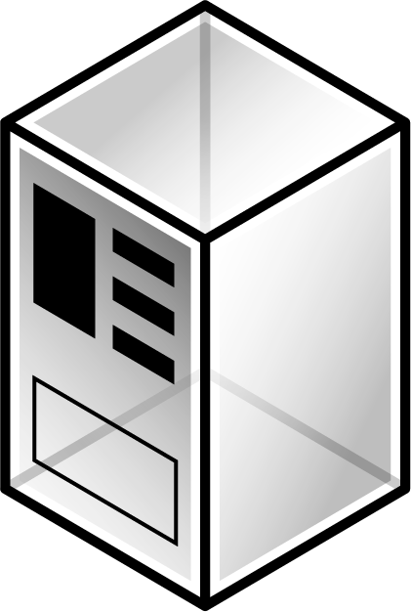
Data Center Network Infrastructure
COMPUTE
Virtual Machines
STORAGE
NAS, DAS, Object
NETWORK
Fabrics, Virtual Routers
Scale Out, Yet Simple to Manage
Notes:
Let me give an example to illustrate our commitment to SIMPLE.
In modern data centers today, you see a broad adoption of scale out design.
<click> Instead of scaling up servers and storage systems, VMs and storage devices are distributed across servers, racks and PODs.
<click>
Networking has to keep up. Our Ethernet Fabric has a scale out architecture allowing customers to build out infrastructure by pooling and virtualizing switch elements. At the same time, the entire fabric can be managed as a single virtual switch. Our Virtual Router follows the same architecture principle. It has a clean separation of control and data planes. Our data plane can be distributed and scale out across a large number of VMs and servers. Yet it is still configured and managed as a single virtual router.
In fact, this architecture addresses one of the most critical data center design requirements from our customer survey – reducing operational cost by reducing management complexity.

Slide 12
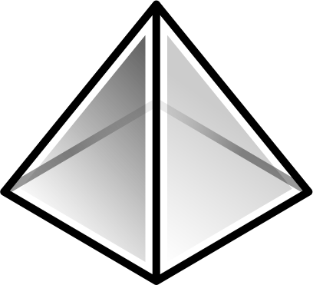
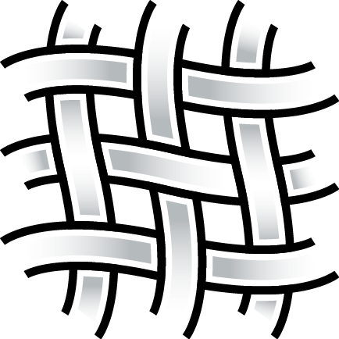
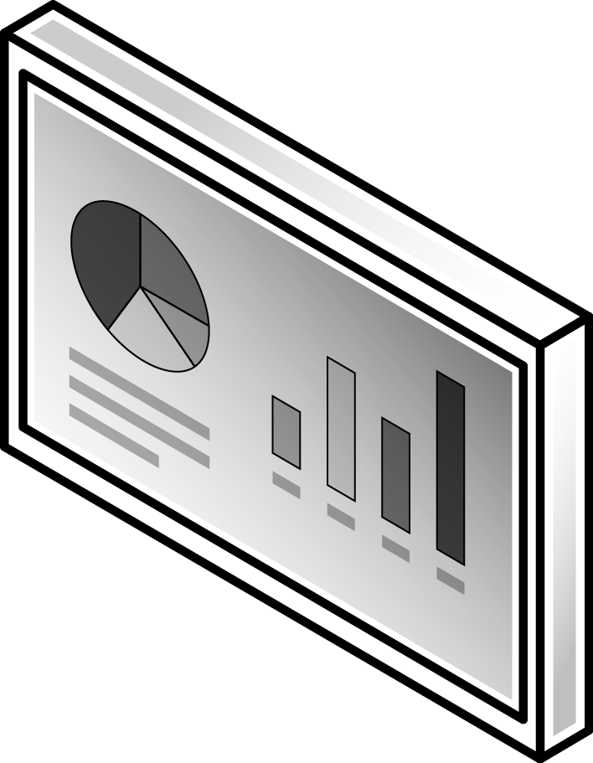
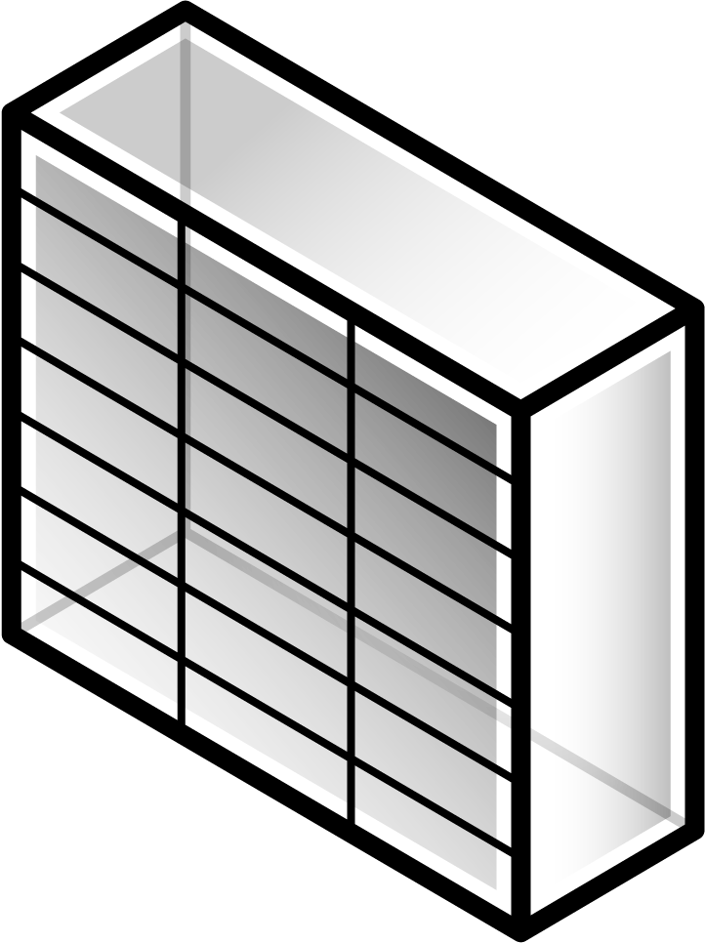
Data Center Network Future
Programmability
Pervasive Visibility
Virtual/Physical Gateway
Fabric
Multitenancy
Notes:
Moving forward, we will evolve Ethernet Fabric along four architecture vectors;
<click, show programmability>
First, it will be highly programmable with an Open API, enabling configuration, resource, state, control and data plane management from the north bound. It will be seamlessly integrated into the orchestration and control environments.
<click, show virtual/physical>
The complexity of the future data centers lies in the interface where virtual meets physical. In highly virtualized environments, Brocade gateway technology will allow customers to integrate the virtual environment with bare metal servers and applications which are difficult to virtualized. We will enable a common orchestration framework for both virtual and physical resources and workload. These innovations will be critical in multitenant hosting or cloud environments where tenants have different degree of virtualization and different tool chains.
<click, show Scalable Multitenancy>
We will deliver a rich set of services base on our Fine Grained Labeling technology. A key area to highlight is scalable multitenancy as operators are looking for traffic isolation, service security, VM mobility, and overlapping address spaces. With our FGL technology and as an alternative to software overlay, we can deliver the multitenant capabilities natively out-of-the-box with our fabric products.
<click, show pervasive visibility>
Lastly, in today’s increasingly complex data center environment, more than ever, customers will need extensive network visibility in order to trouble shoot, diagnose, manage flows and deploy resources optimally. As an example, overlay tunnel traffic is completely opaque to the underlying network so it is difficult to perform traffic optimization and congestion avoidance. Network visibility will be an area where Brocade will invest and innovate.
I should also mention that Ethernet Fabric is ideal as a high performance, low latency interconnect for the new generation of software-defined storage systems. This is particularly true with the emergence of the Flash storage and distributed storage systems where network availability and low latency are assumed. Over time, with its ability to identify and avoid network hotspots, Ethernet Fabric will be essential for the deployment of these new generation of storage systems.

Slide 13

Software Networking Leadership
#1 Virtual Router
1.3M+ downloads
1,000+ customers
Embedded FW, VPN, NAT
In every major public cloud
Brocade Virtual Router
Notes:
Today, our Vyatta Virtual Router is the industry’s leading virtual router with #1 market share. It is broadly deployed in cloud and hosting environments as tenant routers. It is the #1 virtual VPN router connecting enterprise data centers to public cloud. It is also the leading NFV router with integrated FW and NAT capabilities.
We have a global footprint. You will find our virtual routers in Amazon AWS, Amazon GovCloud , Rackspace Open Cloud, SoftLayer and many private clouds today.

Slide 14

Software Networking Future
Scale Up
Ecosystem
Scale Out
Fabrics
Notes:
<click, to show scale up>
Moving forward, we will continue to scale up our virtual router in both control plane and data plane performance. Today Vyatta outperforms our nearest competitor by 10x. We achieve wire-speed 10G performance with 64byte packet using a single Intel Xeon core today. Our architecture will achieve linear performance scale to the number of cores.
<click to show scale out>
We will also scale out our virtual router by distributing data plane across VMs and servers. Virtual routing will scale with compute and storage. At the same time we will virtualize our data plane so that the entire routing fabric can be maintained as a single virtual router, reducing operational complexity.
<click to show fabric>
We will leverage our Ethernet Fabric as “underlay” to enable a higher plane of value by combining the capabilities of Brocade Vyatta virtual router and Ethernet fabric. With the combined Brocade physical and virtual infrastructure, customers can enable sophisticated service chains, better multicast support, correlate network analytics, redirect flows and provide end-to-end traffic visibility.
<click to show ecosystem>
We will continue to make significant investment, through our own contribution and partnership, to enable a vibrant SDN ecosystems and seamlessly integrate our software networking products. We have recently published a Openstack blueprint on dynamic service instantiation which will be demonstrated at the Openstack Summit Hong Kong in November.

Slide 15
Software Networking User Community
250,000 Members
and Growing
Relevance and Recognition
Notes:
We have a Vyatta virtual router community of over ¼ million users today. We will continue put the resources and focus of Brocade behind it.
We understand the value a ubiquitous software footprint. You will hear a lot more about our user community effort in the near future.

Slide 16

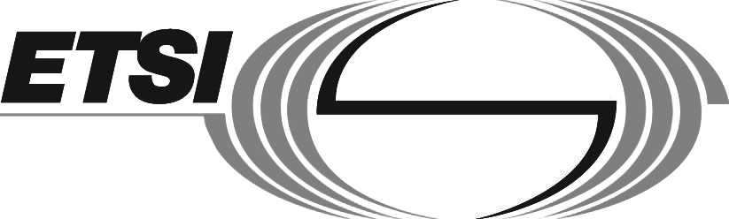

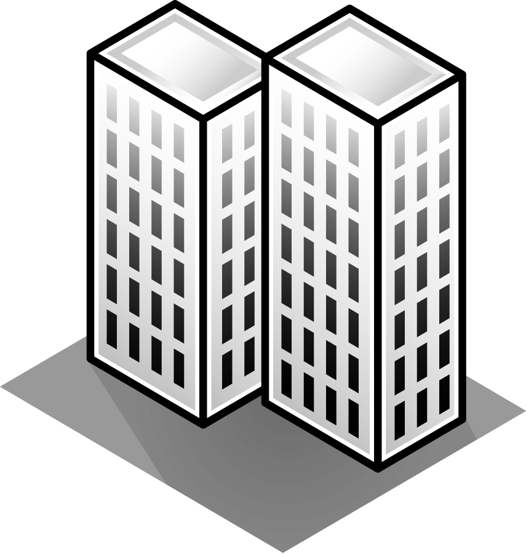


Software-Defined Data Center Networks
Expanding Markets
Service Providers
Open API
Data Center
Innovation
Fabrics
Software
Data Center Networking
Enterprise
Mobile Wireless
Cloud
Notes:
Here is how I would summarize our technology direction. We are making asymmetric bets on data center networking technologies.
<click>
Our core innovations will evolve around driving Ethernet Fabric adoption, and an unbridled software strategy built around virtual routing.
<click>
We are committed to OPEN networking, and will make significant contribution to enhance the ecosystem in which our products operate.
<click>
With this technology underpinning, we will deliver compelling data center solutions to enterprise, service provider, mobile operator and cloud.

Slide 17
Open is core to our strategy
Innovate in Fabric and Virtual Routing
Focus on SDN and NFV use cases
Commitment to open SDN ecosystem
Build a vibrant user community
Notes:
In closing,
Open is the core to our technology strategy.
We will continue to invest and innovate around Ethernet Fabric and Virtual Routing.
We are laser focus on SDN and NFV use cases.
We are committed to enhance an open SDN ecosystem.
And we will be working with our global customers and partners to build a vibrant user community.

Slide 18
Thank you
#BRCDTechDay
Notes:
Thank you.

